Slide 1

Create and program microcontroller
The presentation was made by a student of the IS/b group-21-3-o,
Pushnogub Victor Sergeevich

Slide 2
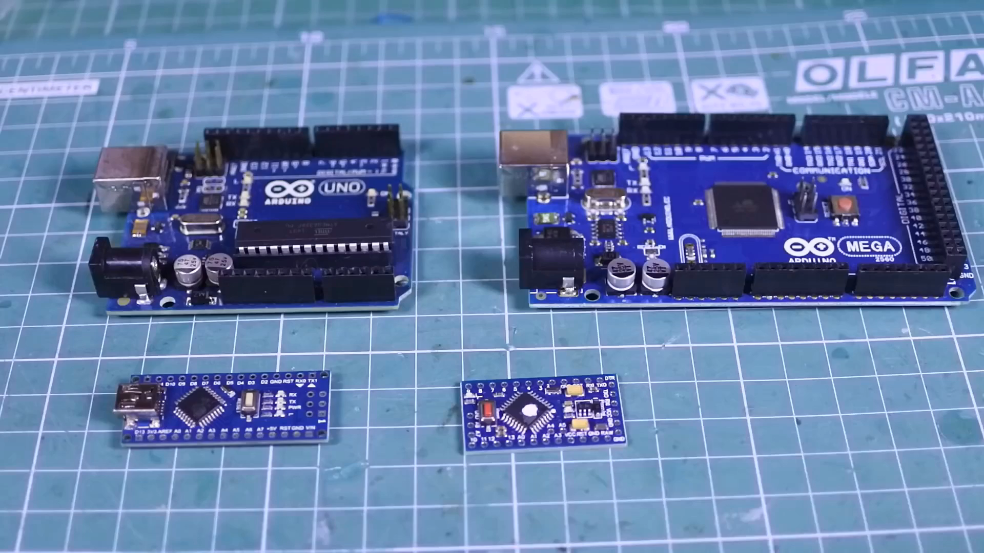
Content:
1. Why did I choose this topic?
2. Why do I need microcontrollers?
2.1. What are microcontrollers made of?
2.2. What programming languages are used for microcontrollers?
3. Conclusion.
4. Sources of information.

Slide 3
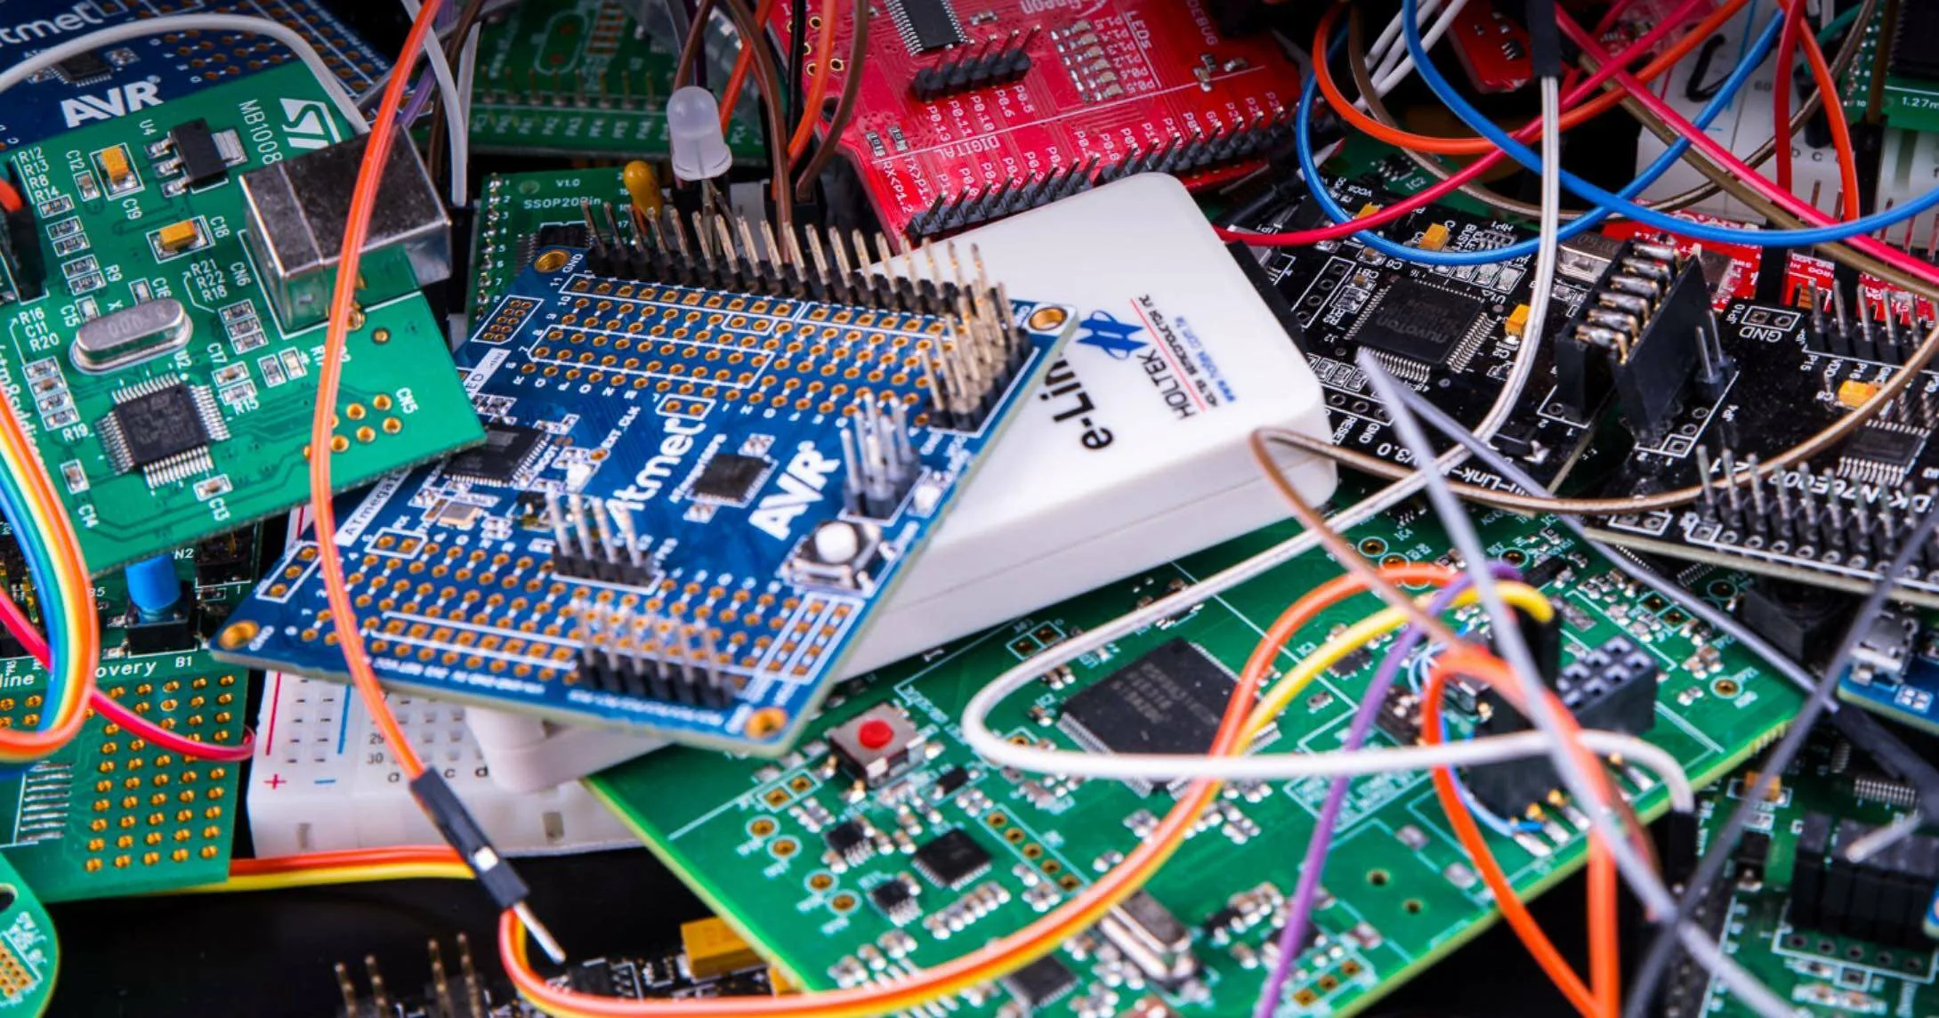
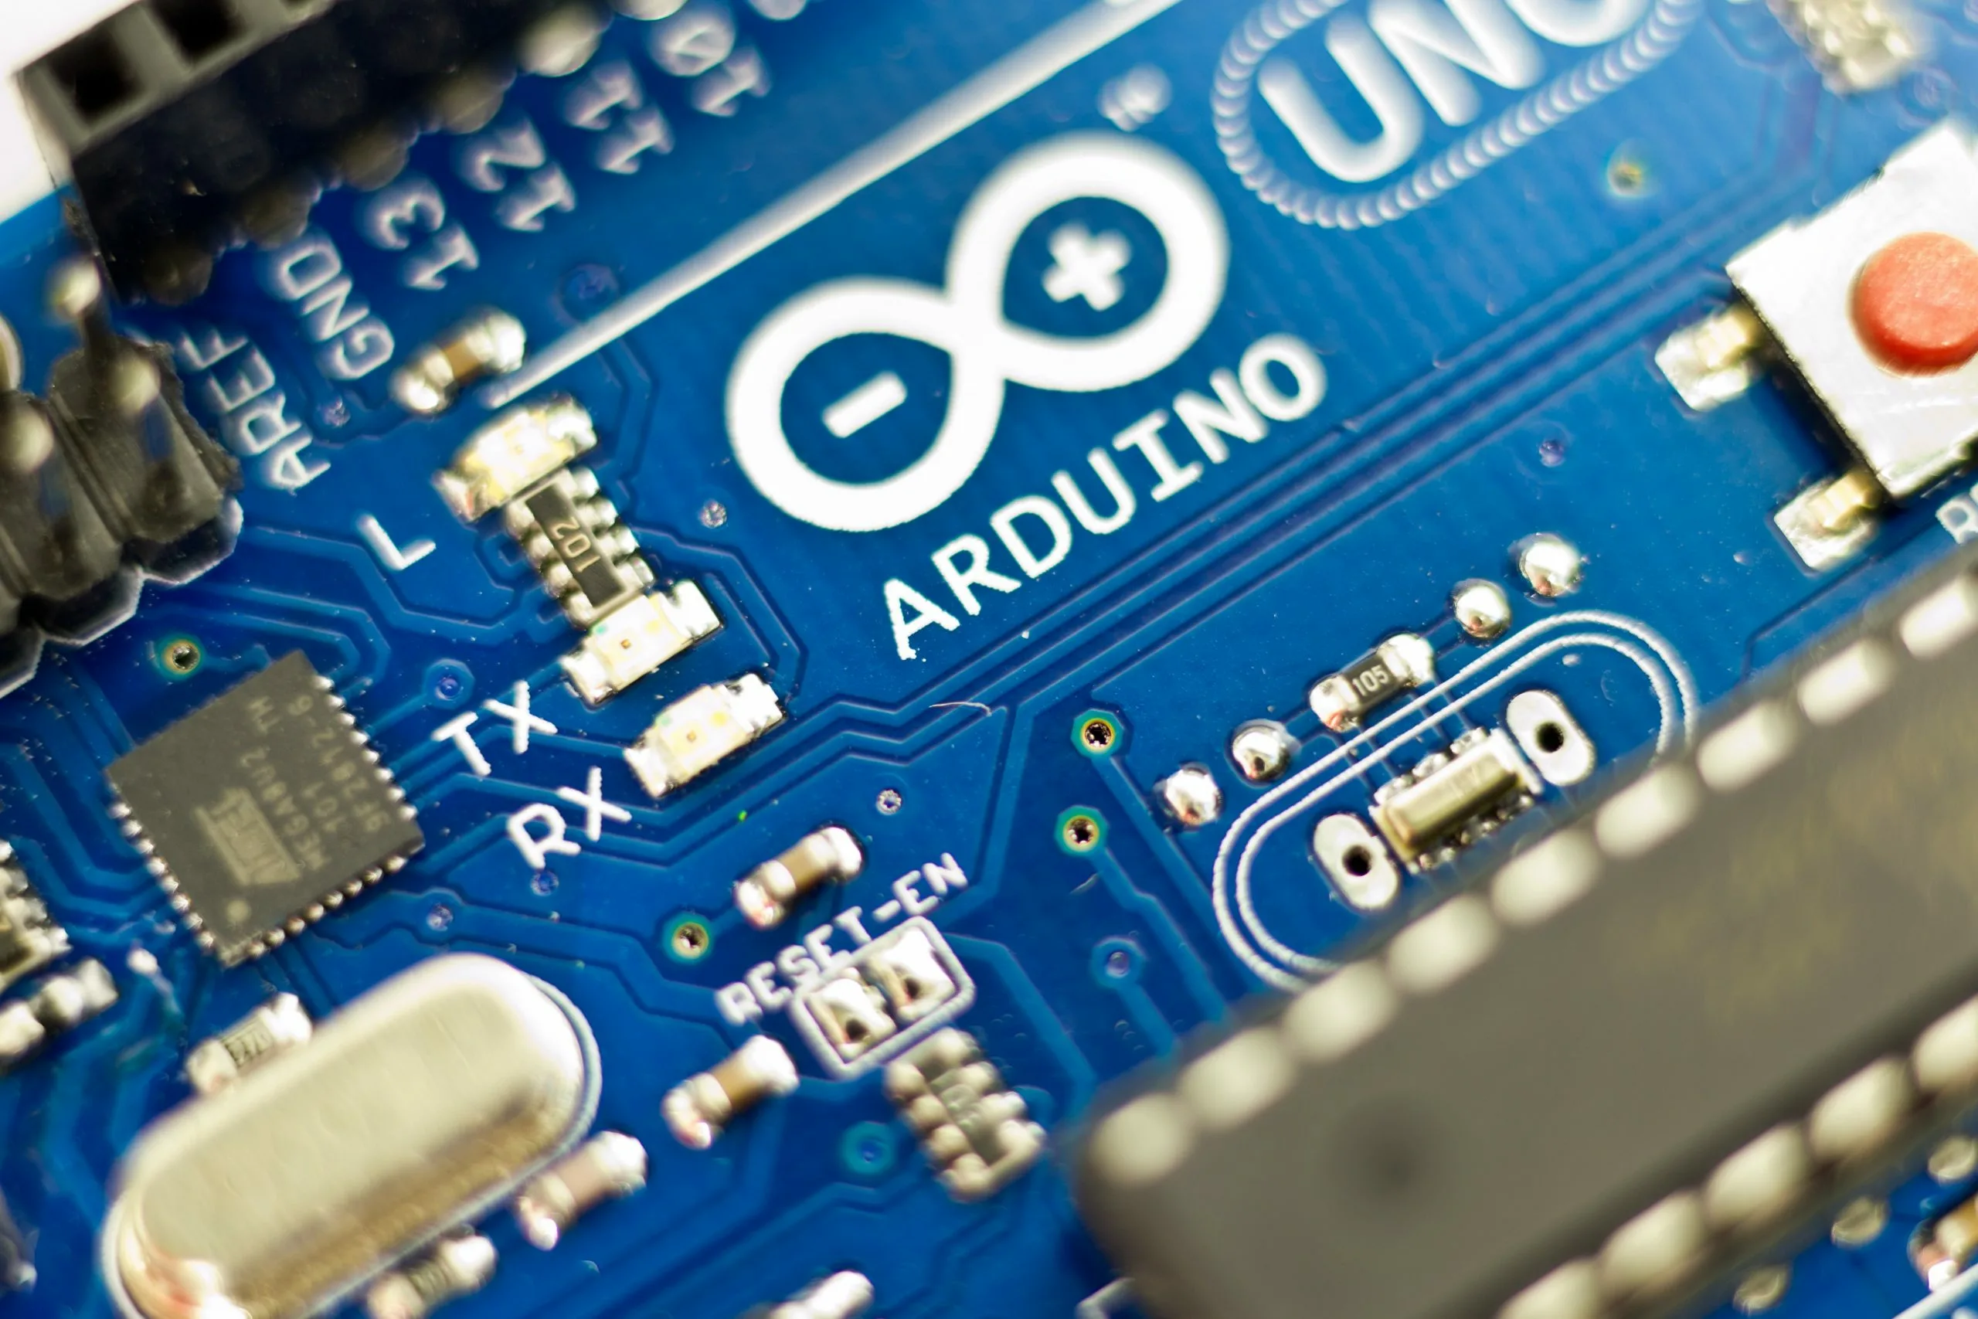
Why did I choose this topic?

Slide 4
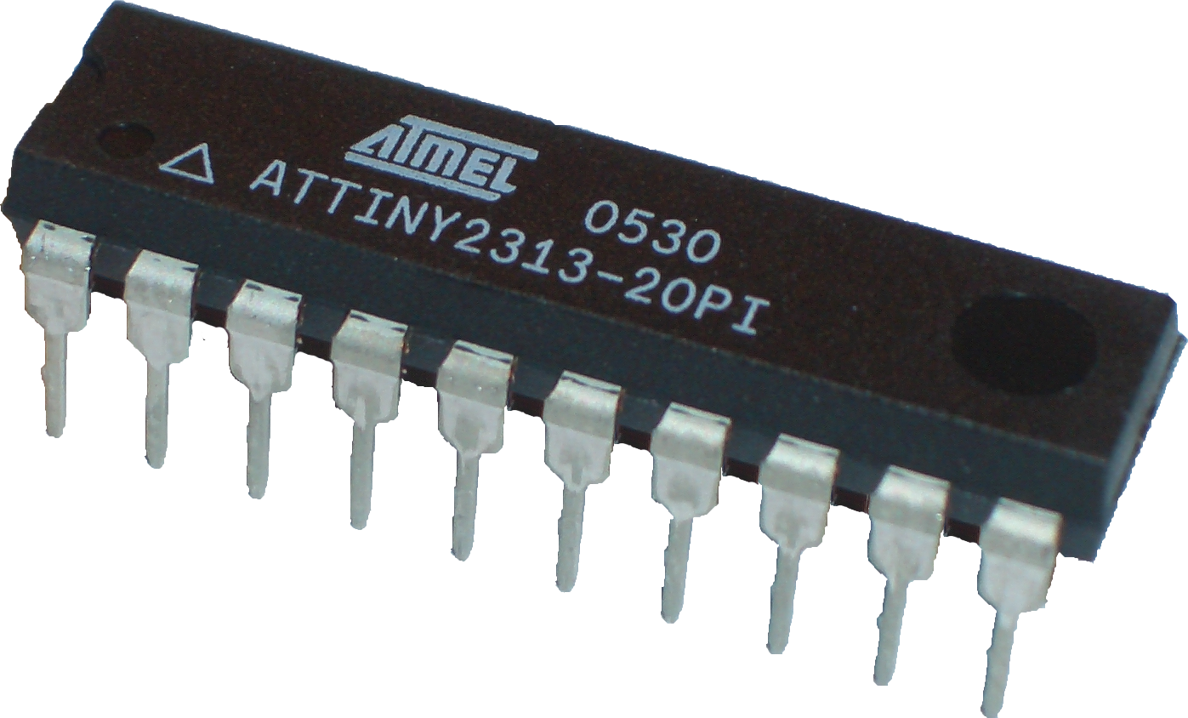
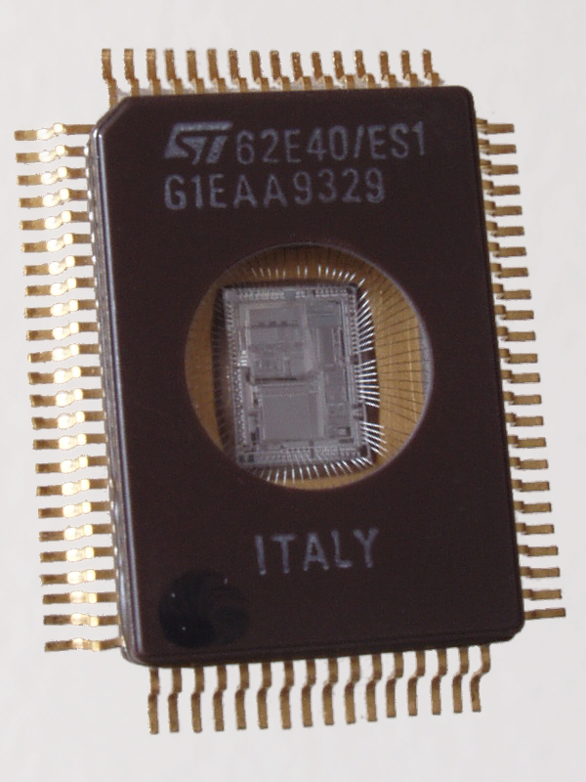
Why do we need microcontrollers?
ATtiny2313 microcontroller from the American company Atmel.
1993 UV-erasable 62E40 microcontroller from STMicroelectronics Europe.

Slide 5
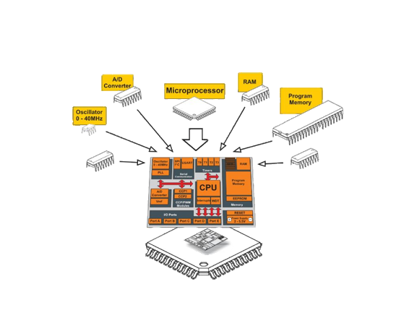
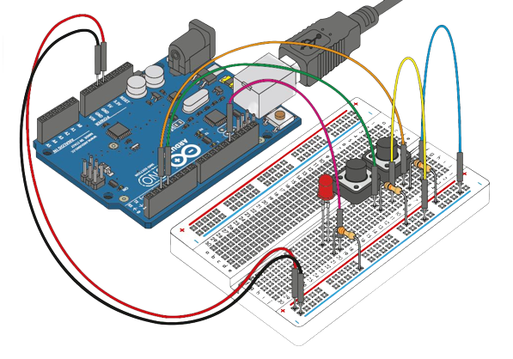
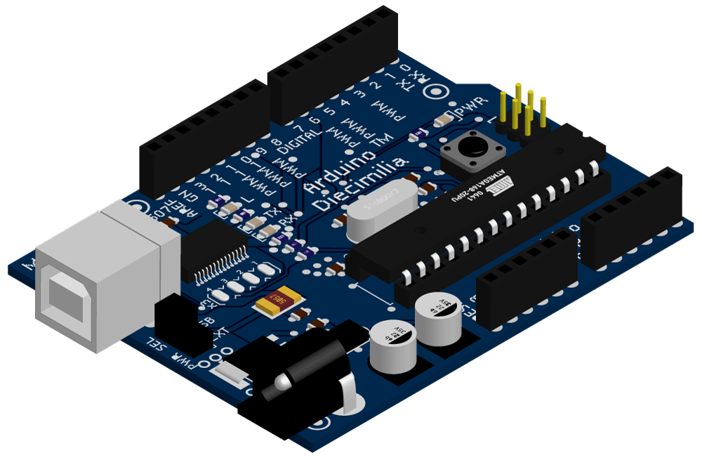
What are microcontrollers made of?

Slide 6

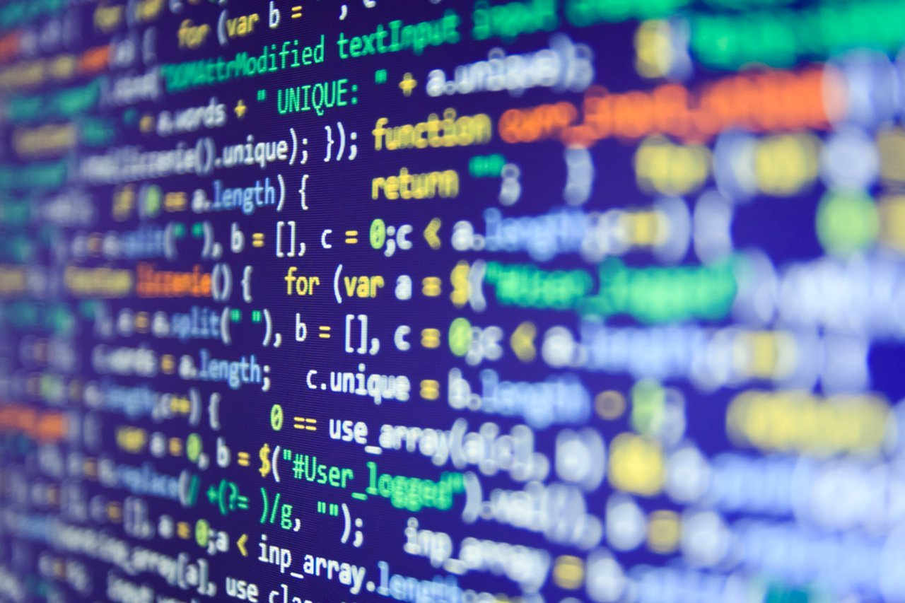


What programming languages are used for microcontrollers?

Slide 7
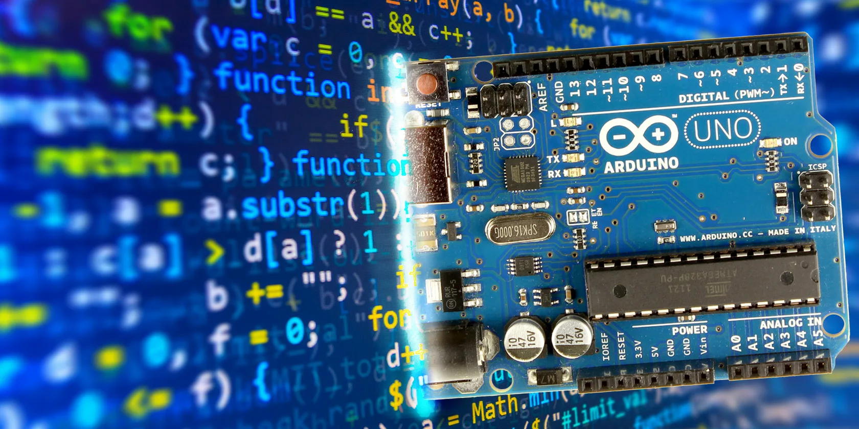
Conclusion

Slide 8
Sources of information:
https://ru.wikipedia.org/wiki/Микроконтроллер
http://electrik.info/main/praktika/1331-pro-mikrokontrollery-dlya-nachinayuschih.html
https://future2day.ru/mikrokontroller/
https://studfile.net/preview/2015273/
https://russianelectronics.ru/files/85884/KiT_nov19.pdf

Slide 9
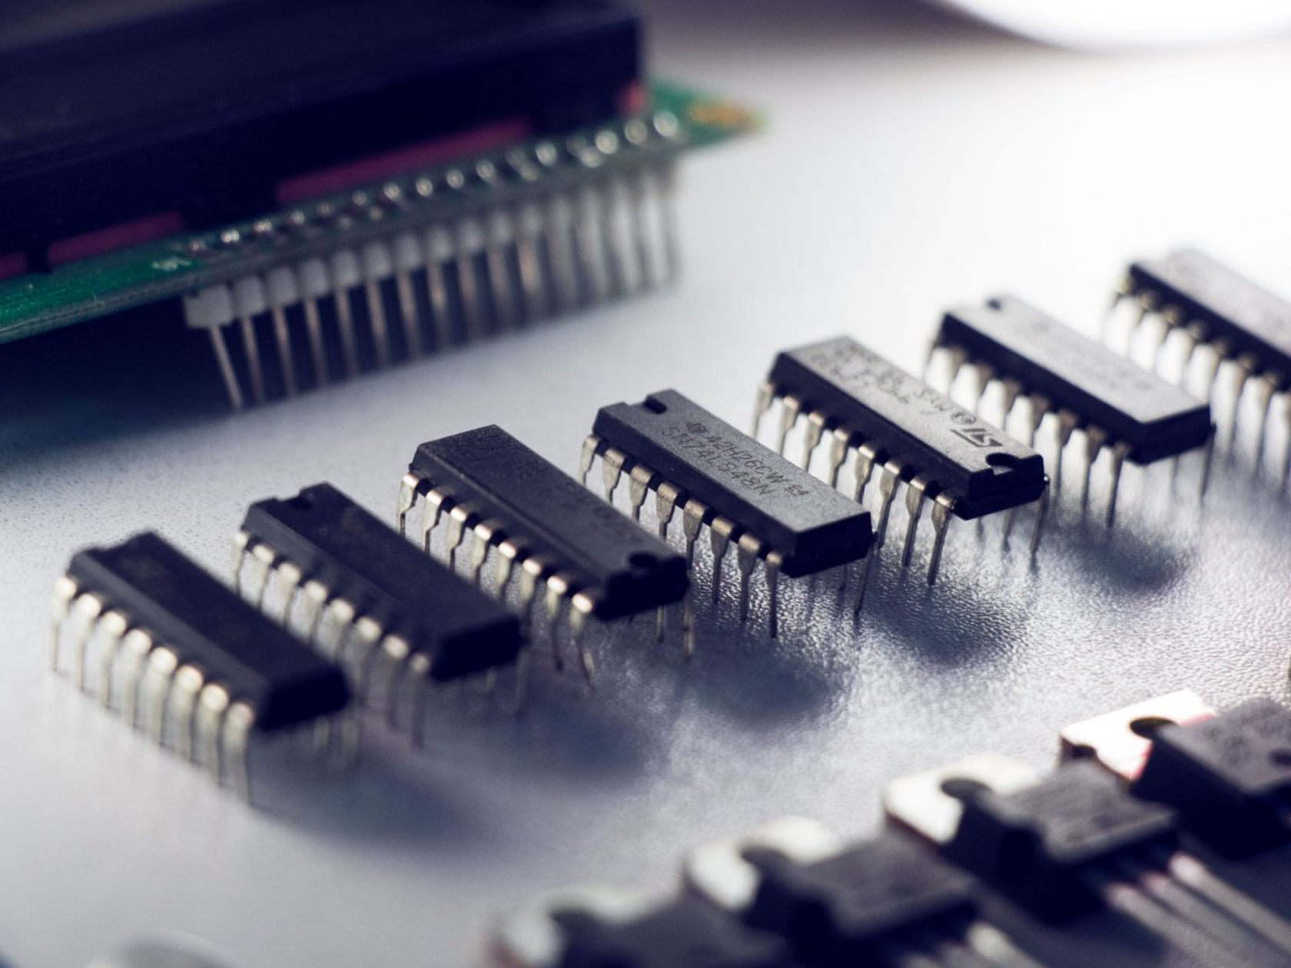
Thanks for your attention!

